Slide 1
Lecture 18 Power in AC Circuits
Hung-yi Lee

Slide 2
Outline
Textbook: Chapter 7.1
Computing Average Power
Maximum Power Transfer for AC circuits
Maximum Power Transfer for DC circuits has been discussed in Chapter 3.1

Slide 3
Average Power for AC Circuits

Slide 4
Review: Power for DC Circuits
Consumed Power for DC Circuits
Resistor with resistance R
A
+
-
B
reference current should flow from “+” to “-”
Negative Communed Power
= Supplied Power

Slide 5
Power for AC Circuits
Consumed Instantaneous Power
If p(t) is periodic with period T
Average Power
A
+
-
B

Slide 6
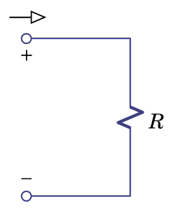
Average Power for AC Circuits
Network
Z
Notes:
Constant plus 2 w

Slide 7
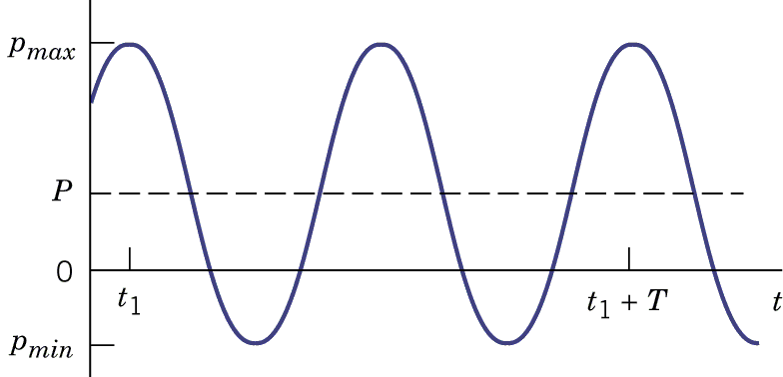
Average Power for AC Circuits
Absorb power
Supply power
Notes:
The cos can be between -1 and 1

Slide 8
Average Power for AC Circuits
Network
Z
Notes:
Constant plus 2 w

Slide 9
Average Power for AC Circuits
Network
Z

Slide 10
Summary

Slide 11
Revisit Maximum Power Transfer

Slide 12
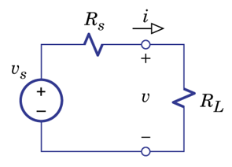
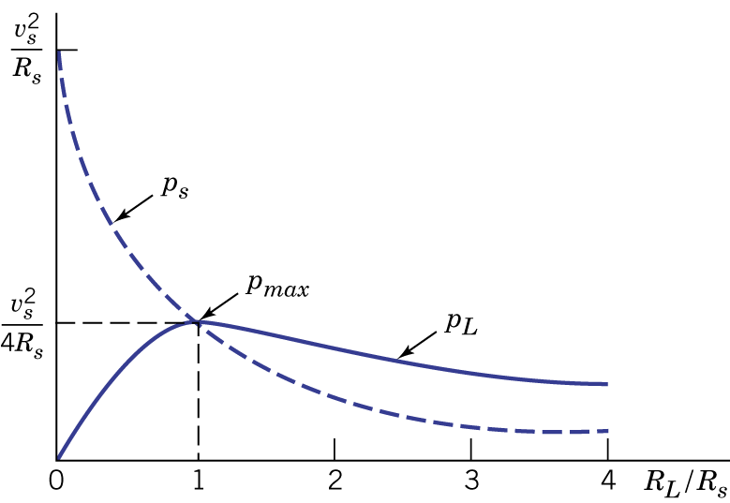
Review: Maximum Power Transfer for DC Circuits
power
Power consumed by R_{s}
Device (Load)
Real source
Power consumed by R_{L}
R_{s} is fixed, increase R_{L}

Slide 13
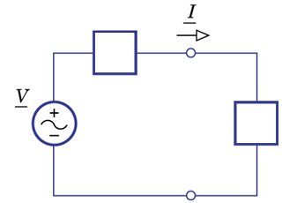
Maximum Power Transfer for AC Circuits
Device (Load)
Real source
Real source
Device (Load)
Source Impedance:
Find Z_{L} such that the device can obtain maximum power

Slide 14
Maximum Power Transfer for AC Circuits
Voltage Source:
Real source
Device (Load)

Slide 15
Maximum Power Transfer for AC Circuits
Find Z_{L} that maximize P
Find X_{L} and R_{L} that maximize P
X_{L} = -X_{s}
R_{L} = R_{s}
Notes:
Compare with DC

Slide 16
Maximum Power Transfer for AC Circuits
Only |Z_{L}| can be tuned
θ is fixed
(R/X is fixed)
P_{L} is maximized when
Special case:
If

Slide 17
Maximum Power Transfer for AC Circuits – Example 1
Determine Z_{L} that maximize the power drawn from the circuit. What is the maximum power?

Slide 18
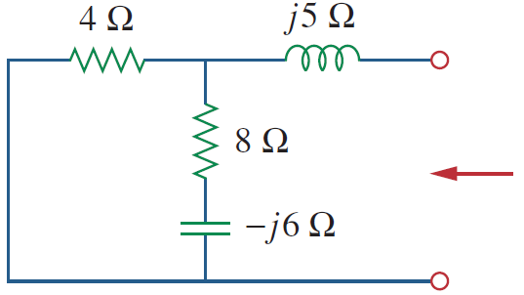
Maximum Power Transfer for AC Circuits – Example 1
Network
Find Z_{T}

Slide 19
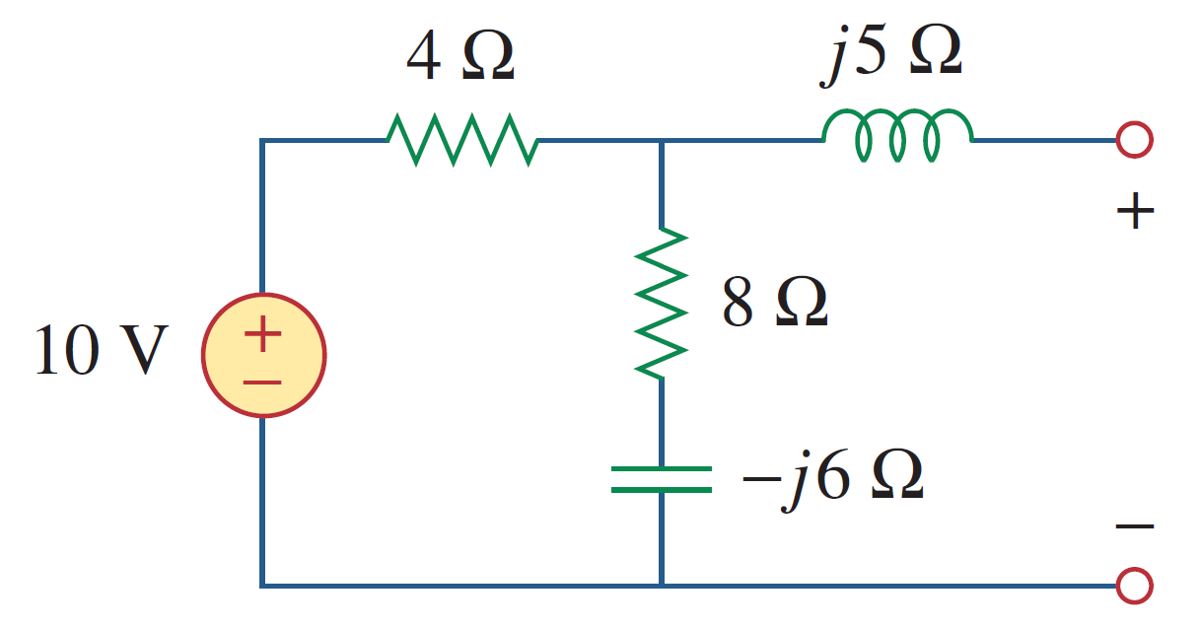
Maximum Power Transfer for AC Circuits – Example 1
Network

Slide 20
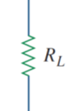
Maximum Power Transfer for AC Circuits – Example 2
Find R_{L} that can absorb maximum power

Slide 21
Maximum Power Transfer for AC Circuits
Power Transfer Efficiency:
Real source
Device (Load)

Slide 22
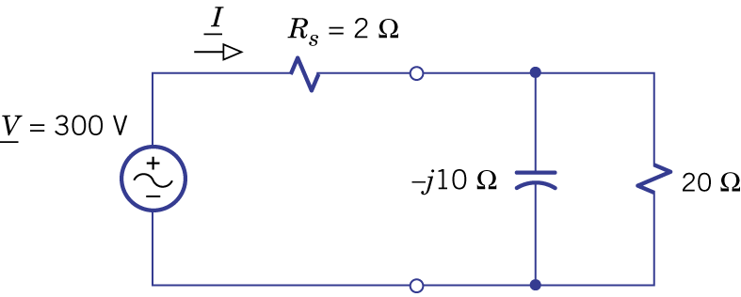
Example 7.4
Real source
Device (Load)
Find Power Transfer Efficiency
Real source
Device (Load)

Slide 23
Example 7.4
Real source
Device (Load)

Slide 24
Homework
7.4, 7.14, 7.20

Slide 25
Thank you!

Slide 26
Answer
7.4: Irms = 5.65mA, 160mW
7.14: R=141Ω, C=0.707μF
7.20: (a) (12-5j)k Ω, 120 μW, 50%; (b) (10.4-7.8j)k Ω, 90 μW, 46%; (c) 13k Ω, 115 μW, 52%

Slide 27
Acknowledgement
感謝 吳東運(b02)
指出投影片中的錯誤

